Slide 1
Event classes and let root recognized them (How to)
Chi WANG (chiwang@mail.ustc.edu.cn)
Guangshun HUANG (hgs@ustc.edu.cn)

Slide 2
Introduction
AMS-02, BES-III use the technical, indeed.
All classes inherit from TObject of root, in order to use I/O of root. It will be convenient for data change in different packages.
Advantages
more clearly structure
easier to write and read root file
could use all functions of TObject, and I/O of root
convenient for information change between different sub-detector
We propose design all classes firstly
The next example will prove the conclusions above, and explain technical details.
Notes:
所以我们建议采取这种方式，现阶段需要设计好class的，及各个class的层次关系。

Slide 3
Example
To explain:
How to write and integrate your class into root?
How to use them to generate a root file like the structure of data format of BES-III?
Does it really convenient while writing and reading root files if we do so?
Example：
http://dpnc.unige.ch/trac/dampe/browser/DmpSoftware/branches/Technical_USTC/rootcintSharedLib
How to run: read Readme.md
Notes:
例子在

Slide 4
How to write and integrate your class into root
Sub-directory: createLib

Slide 5
write and integrate your class into root
Key points：
Derive MyClass from TObject
Write LinkDef.h
Generate dictionary by using rootcint
Compile source files of MyClass and Dictionary, to create a shared library

Slide 6
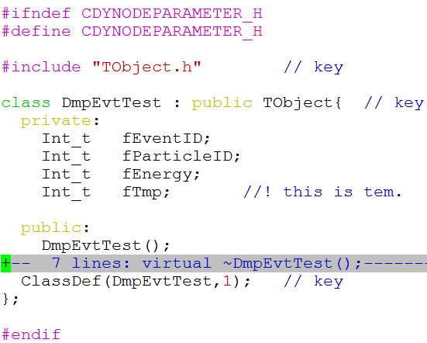
write and integrate your class into root (DmpEvtTest.hh)
Public derive from TObject
Must define the default constructor
>= 1 use I/O of root； 0 NOT use I/O of root.

Slide 7
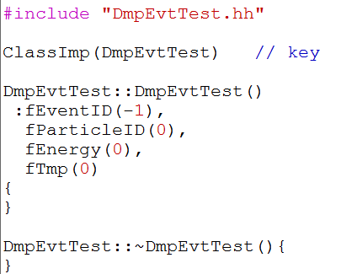
write and integrate your class into root (DmpEvtTest.cc)

Slide 8
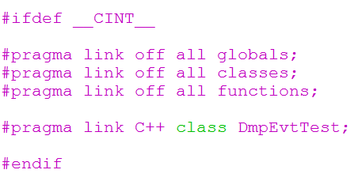
write and integrate your class into root (TestLinkDef.h)
Must include string ”LinkDef”, like MyLinkDef.hh, TestLinkDef2.h
Tell root to link which class
Sytanx of LinkDef file:
http://root.cern.ch/download/doc/ROOTUsersGuide.html#the-linkdef.h-file

Slide 9
write and integrate your class into root (use rootcint)
rootcint –f DmpEvtTest_Dict.cc –c –p DmpEvtTest.hh TestLinkDef.h
The last file must be LinkDef.h
Then will generate the dictionary: DmpEvtTest_Dict.cc and DmpEvtTest_Dict.h
Create shared library use:
DmpEvtTest.cc and DmpEvtTest_Dict.cc
Execute “scons” under createLib, will do the 2 steps above, and
create libDmpEvtTest.so
Notes:
小结一下，1.必须从Tobject 里面派生，2. 必须写LinkDef文件

Slide 10
How to write the data members of DmpEvtTest into a root file
Sub-directory: useLib_Write

Slide 11
Create root file
Key points：
include DmpEvtTest.hh (requirement of compilation)
Link libDmpEvtTest.so (compiling and running)
Define Branch by using this function of Tree:
Reference (Case B):
http://root.cern.ch/root/html/TTree.html

Slide 12
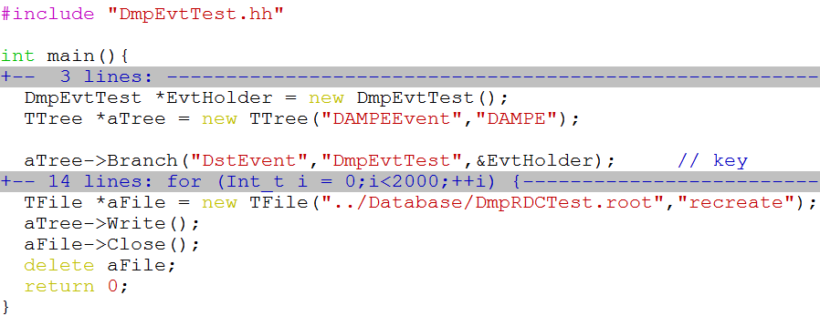
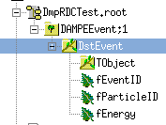
Create root file (uselibDmpEvtTeest_Write.cc)
Notes:
编译运行后得到右下角结构的数据文件。定义Branch使用class 名字，数据成员直接是leaves。 //! 表示该数据成员不写入root文件。Rootcint的语法。回顾BES-III的结构

Slide 13
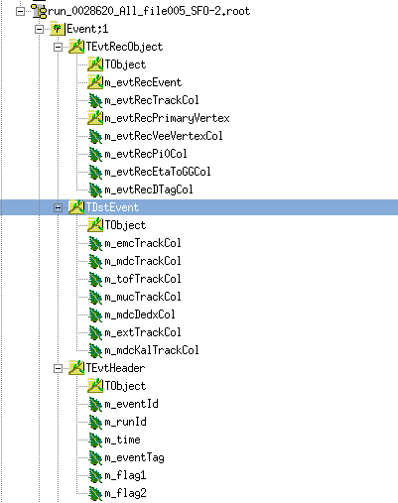
Event format of BES-III
Tree
Branches
Our example could get the same structure of root file
as event format of BES-III:
Other Branches are the same as TDstEvent.
Note: TEvtRecObject
Notes:
再看BES-III的数据文件，可以证实它是采用了这样的方式。为什么说AMS也是这样做的呢？ 因为这样的方式有2个特点，一是必须从Tobject里面派生出来，这是为了用root的I/O，二是，必须写LinkDef文件，说明如何将哪些class挂到root里面去。

Slide 14
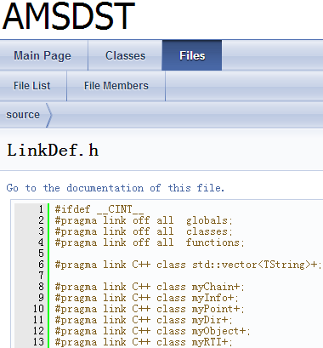
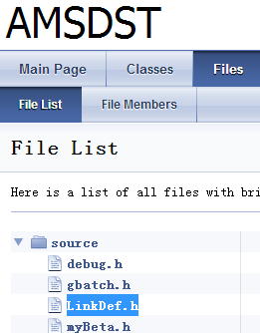
Provence of AMSDST
AMSDST: http://ntuplizeamsfiles.sourceforge.net/classes.html
(1) all class inherited TObject
(2) LinkDef.h file
Link of LinkDef.h：
http://ntuplizeamsfiles.sourceforge.net/LinkDef_8h_source.html

Slide 15
How to read the data members of DmpEvtTest from a root file
Sub-directory: useLib_Read

Slide 16
Read root file
Key points：
include DmpEvtTest.hh (requirement of compilation)
Link libDmpEvtTest.so (compiling and running)
Read Branch by using this function of Tree:
Reference (Case B):
http://root.cern.ch/root/html/TTree.html

Slide 17
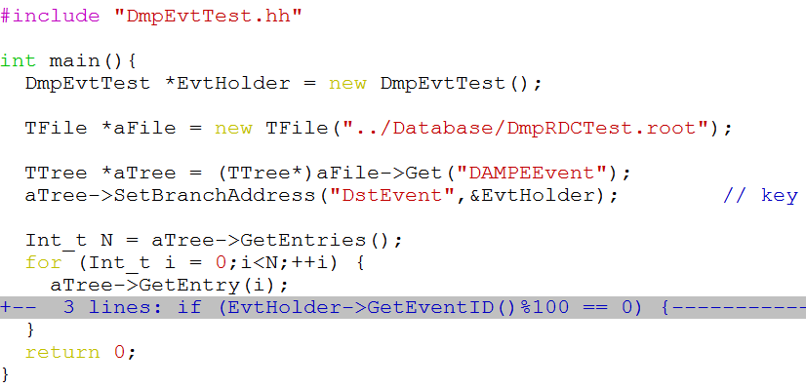
Read root file (uselibDmpEvtTest_Read.cc)
Notes:
Ttree的其他函数一样使用。

Slide 18
writing and reading are match
Execute write root file (libDmpEvtTest_Write),
If (EventID % 100 == 0), Print event information
Execute read root file (libDmpEvtTest_Read),
If (EventID % 100 == 0), Print event information
They are the same.
Run example…

Slide 19
Summary
We show the method of AMS and BES how to develop their software:
Integrate their classes and shared library into root
Write an example to explain how to do so.
We propose DMPSW should take this method.
First of all, design classes and their relationship.

Slide 20
Reference
Source file of Root:
Like package: TMVA or RooFit are good examples.
Them were integrated into root as the way mentioned above
Users guide of Root:
http://root.cern.ch/download/doc/ROOTUsersGuide.html#the-linkdef.h-file
Chapter 15, Adding class
Chapter 7, Cint
AMSDST: http://ntuplizeamsfiles.sourceforge.net/classes.html
Our example is at dampe@ustc : /home/chi/rootcintSharedLib.tar.gz

Slide 21
Thank you

